Slide 1
Cryptography and Network Security
Chapter 11
Fourth Edition
by William Stallings
Lecture slides by Lawrie Brown
Notes:
Lecture slides by Lawrie Brown for “Cryptography and Network Security”, 4/e, by William Stallings, Chapter 11 – “Message Authentication and Hash Functions”.

Slide 2
Chapter 11 – Message Authentication and Hash Functions
At cats' green on the Sunday he took the message from the inside of the pillar and added Peter Moran's name to the two names already printed there in the "Brontosaur" code. The message now read: “Leviathan to Dragon: Martin Hillman, Trevor Allan, Peter Moran: observe and tail.” What was the good of it John hardly knew. He felt better, he felt that at last he had made an attack on Peter Moran instead of waiting passively and effecting no retaliation. Besides, what was the use of being in possession of the key to the codes if he never took advantage of it?
—Talking to Strange Men, Ruth Rendell
Notes:
Opening quote.

Slide 3
Message Authentication
message authentication is concerned with:
  protecting the integrity of a message
  validating identity of originator
  non-repudiation of origin (dispute resolution)
will consider the security requirements
then three alternative functions used:
  message encryption
  message authentication code (MAC)
  hash function
Notes:
Up untill now, have been concerned with protecting message content (ie secrecy) by encrypting the message. Will now consider how to protect message integrity (ie protection from modification), as well as confirming the identity of the sender. Generically this is the problem of message authentication, and in eCommerce applications is arguably more important than secrecy. Message Authentication is concerned with: protecting the integrity of a message, validating identity of originator, & non-repudiation of origin (dispute resolution). There are three types of functions that may be used to produce an authenticator: message encryption, message authentication code (MAC), or a hash function.

Slide 4
Security Requirements
disclosure
traffic analysis
masquerade
content modification
sequence modification
timing modification
source repudiation
destination repudiation
Notes:
In the context of communications across a network, the attacks listed above can be identified.
The first two requirements belong in the realm of message confidentiality, and are handled using the encryption techniques already discussed.
The remaining requirements belong in the realm of message authentication. At its core this addresses the issue of ensuring that a message comes from the alleged source and has not been altered. It may also address sequencing and timeliness. The use of a digital signature can also address issues of repudiation by the source.

Slide 5
Message Encryption
message encryption by itself also provides a measure of authentication
if symmetric encryption is used then:
  receiver know sender must have created it
  since only sender and receiver now key used
  know content cannot of been altered
  if message has suitable structure, redundancy or a checksum to detect any changes
Notes:
Message encryption by itself can provide a measure of authentication. Here, the ciphertext of the entire message serves as its authenticator, on the basis that only those who know the appropriate keys could have validly encrypted the message. This is provided you can recognize a valid message (ie if the message has suitable structure such as redundancy or a checksum to detect any changes).

Slide 6
Message Encryption
if public-key encryption is used:
  encryption provides no confidence of sender
  since anyone potentially knows public-key
  however if
    sender signs message using their private-key
    then encrypts with recipients public key
    have both secrecy and authentication
  again need to recognize corrupted messages
  but at cost of two public-key uses on message
Notes:
With public-key techniques, can get a digital signature which can only have been created by key owner. But at cost of two public-key operations at each end on message.

Slide 7
Message Authentication Code (MAC)
generated by an algorithm that creates a small fixed-sized block
  depending on both message and some key
  like encryption though need not be reversible
appended to message as a signature
receiver performs same computation on message and checks it matches the MAC
provides assurance that message is unaltered and comes from sender
Notes:
An alternative authentication technique involves the use of a secret key to generate a small fixed-size block of data, known as a cryptographic checksum or MAC that is appended to the message. This technique assumes that two communicating parties, say A and B, share a common secret key K. A MAC function is similar to encryption, except that the MAC algorithm need not be reversible, as it must for decryption.

Slide 8
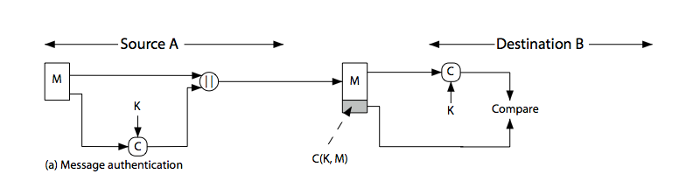
Message Authentication Code
Notes:
Stallings Figure 11.4a “Message Authentication” shows the use of a MAC just for authentication.

Slide 9
Message Authentication Codes
as shown the MAC provides authentication
can also use encryption for secrecy
  generally use separate keys for each
  can compute MAC either before or after encryption
  is generally regarded as better done before
why use a MAC?
  sometimes only authentication is needed
  sometimes need authentication to persist longer than the encryption (eg. archival use)
note that a MAC is not a digital signature since both sender and receiver share key and could create it
Notes:
Can combine use of MAC with encryption in various ways to provide both authentication & secrecy.
Use MAC in circumstances where just authentication is needed (or needs to be kept), see text for examples.
A MAC is NOT a digital signature since both sender & receiver share key and could create it.

Slide 10
MAC Properties
a MAC is a cryptographic checksum
  MAC = C_{K}(M)
  condenses a variable-length message M
  using a secret key K
  to a fixed-sized authenticator
is a many-to-one function
  potentially many messages have same MAC
  but finding these needs to be very difficult
Notes:
A MAC, also known as a cryptographic checksum,is generated by a function C. The MAC is appended to the message at the source at a time when the message is assumed or known to be correct. The receiver authenticates that message by re-computing the MAC.
The MAC function is a many-to-one function, since potentially many arbitrarily long messages can be condensed to the same summary value, but don’t want finding them to be easy!

Slide 11
Requirements for MACs
taking into account the types of attacks
need the MAC to satisfy the following:
  knowing a message and MAC, is infeasible to find another message with same MAC
  MACs should be uniformly distributed
  MAC should depend equally on all bits of the message
Notes:
In assessing the security of a MAC function, we need to consider the types of attacks that may be mounted against it. Hence it needs to satisfy the listed requirements.
The first requirement deals with message replacement attacks, in which an opponent is able to construct a new message to match a given MAC, even though the opponent does not know and does not learn the key.
The second requirement deals with the need to thwart a brute-force attack based on chosen plaintext.
The final requirement dictates that the authentication algorithm should not be weaker with respect to certain parts or bits of the message than others.

Slide 12
Using Symmetric Ciphers for MACs
can use any block cipher chaining mode and use final block as a MAC
Data Authentication Algorithm (DAA) is a widely used MAC based on DES-CBC
  using IV=0 and zero-pad of final block
  encrypt message using DES in CBC mode
  and send just the final block as the MAC
    or the leftmost M bits (16≤M≤64) of final block
but final MAC is now too small for security
Notes:
Can also use block cipher chaining modes to create a separate authenticator, by just sending the last block. This was done with the Data Authentication Algorithm (DAA), a widely used MAC based on DES-CBC (next slide). However this suffers from being too small for acceptable use today.

Slide 13
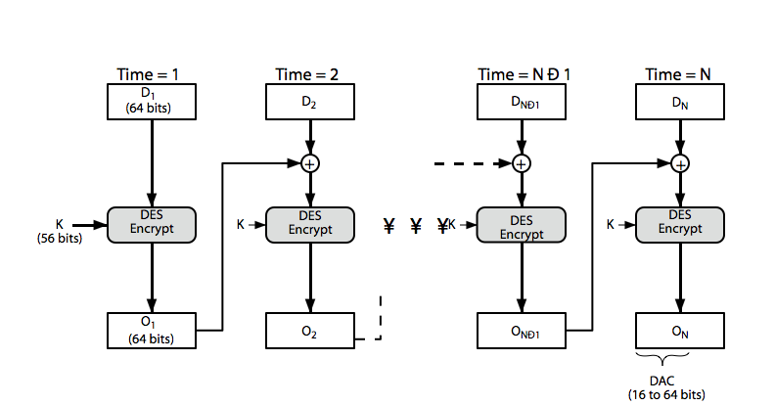
Data Authentication Algorithm
Notes:
Stallings Figure 11.6 “Data Authentication Algorithm”, illustrates the FIPS PUB 113 / ANSI X9.17 MAC based on DES-CBC with IV 0 and 0-pad of the final block if needed. Resulting MAC can be 16-64 bits of the final block. But this is now too small for security.

Slide 14
Hash Functions
condenses arbitrary message to fixed size
  h = H(M)
usually assume that the hash function is public and not keyed
  cf. MAC which is keyed
hash used to detect changes to message
can use in various ways with message
most often to create a digital signature
Notes:
A variation on the message authentication code is the one-way hash function. As with the message authentication code, a hash function accepts a variable-size message M as input and produces a fixed-size output, referred to as a hash code H(M). Unlike a MAC, a hash code does not use a key but is a function only of the input message. The hash code is also referred to as a message digest or hash value.

Slide 15
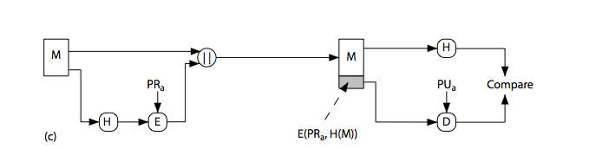
Hash Functions & Digital Signatures
Notes:
Stallings Figure 11.5c “Basic Uses of Hash Functions” shows the hash being “signed” with the senders private key, thus forming a digital signature.

Slide 16
Requirements for Hash Functions
can be applied to any sized message M
produces fixed-length output h
is easy to compute h=H(M) for any message M
given h is infeasible to find x s.t. H(x)=h
  one-way property
given x is infeasible to find y s.t. H(y)=H(x)
  weak collision resistance
is infeasible to find any x,y s.t. H(y)=H(x)
  strong collision resistance
Notes:
The purpose of a hash function is to produce a “fingerprint”of a file, message, or other block of data.
These are the specifications for good hash functions. Essentially it must be extremely difficult to find 2 messages with the same hash, and the hash should not be related to the message in any obvious way (ie it should be a complex non-linear function of the message). There are quite a few similarities in the evolution of hash functions & block ciphers, and in the evolution of the design requirements on both.

Slide 17
Simple Hash Functions
are several proposals for simple functions
based on XOR of message blocks
not secure since can manipulate any message and either not change hash or change hash also
need a stronger cryptographic function (next chapter)
Notes:
All hash functions operate using the following general principles. The input (message, file,etc.) is viewed as a sequence of n-bit blocks, processed one block at a time in an iterative fashion to produce an n-bit hash function. Can construct a range of possible simple hash functions by just XOR’ing blocks with rotates etc. None of these are secure, since can predict how changes to message affect the resulting hash.

Slide 18
Birthday Attacks
might think a 64-bit hash is secure
but by Birthday Paradox is not
birthday attack works thus:
  opponent generates 2^{m/2} variations of a valid message all with essentially the same meaning
  opponent also generates 2^{m/2} variations of a desired fraudulent message
  two sets of messages are compared to find pair with same hash (probability > 0.5 by birthday paradox)
  have user sign the valid message, then substitute the forgery which will have a valid signature
conclusion is that need to use larger MAC/hash
Notes:
The Birthday Attack exploits the birthday paradox – the chance that in a group of people two will share the same birthday – only 23 people are needed for a Pr>0.5 of this. Can generalize the problem to one wanting a matching pair from any two sets, and show need 2^{m/2} in each to get a matching m-bit hash.
Note that creating many message variants is relatively easy, either by rewording or just varying the amount of white-space in the message. All of which indicates that larger MACs/Hashes are needed.

Slide 19
Block Ciphers as Hash Functions
can use block ciphers as hash functions
  using H₀=0 and zero-pad of final block
  compute: H_{i} = E_{Mi} [H_{i-1}]
  and use final block as the hash value
  similar to CBC but without a key
resulting hash is too small (64-bit)
  both due to direct birthday attack
  and to “meet-in-the-middle” attack
other variants also susceptible to attack
Notes:
A number of proposals have been made for hash functions based on using a cipher block chaining technique, but without the secret key (instead using the message blocks as keys). Unfortunately these are subject to both the birthday attack, and to a “meet-in-the-middle” attack. Thus, attention has been directed at finding other approaches to hashing.

Slide 20
Hash Functions & MAC Security
like block ciphers have:
brute-force attacks exploiting
  strong collision resistance hash have cost 2^{m/2}
    have proposal for h/w MD5 cracker
    128-bit hash looks vulnerable, 160-bits better
  MACs with known message-MAC pairs
    can either attack keyspace (cf key search) or MAC
    at least 128-bit MAC is needed for security
Notes:
Just as with symmetric and public-key encryption, we can group attacks on hash functions and MACs into two categories: brute-force attacks and cryptanalysis.
The strength of a hash function against brute-force attacks depends solely on the length of the hash code produced by the algorithm, with cost O(2^m/2). See proposal in text for a h/w MD5 cracker.
A brute-force attack on a MAC is a more difficult undertaking because it requires known message-MAC pairs. However analysis shows cost is related to min(2^k, 2^n), similar to symmetric encryption algorithms.

Slide 21
Hash Functions & MAC Security
cryptanalytic attacks exploit structure
  like block ciphers want brute-force attacks to be the best alternative
have a number of analytic attacks on iterated hash functions
  CV_{i} = f[CV_{i-1}, M_{i}]; H(M)=CV_{N}
  typically focus on collisions in function f
  like block ciphers is often composed of rounds
  attacks exploit properties of round functions
Notes:
As with encryption algorithms, cryptanalytic attacks on hash functions and MAC algorithms seek to exploit some property of the algorithm to perform some attack other than an exhaustive search. The way to measure the resistance of a hash or MAC algorithm to cryptanalysis is to compare its strength to the effort required for a brute-force attack. That is, an ideal hash or MAC algorithm will require a cryptanalytic effort greater than or equal to the brute-force effort.
Cryptanalysis of hash functions focuses on the internal structure of the compression function f and is based on attempts to find efficient techniques for producing collisions for a single execution of f. Keep in mind that for any hash function there must exist collisions, but want it to be computationally infeasible to find these collisions.

Slide 22
MD5
Designed by Ronald Rivest (the R in RSA)
Latest in a series of MD2, MD4
Produce a hash value of 128 bits (16 bytes)
Until recently was the most widely used hash algorithm
  in recent times have both brute-force and cryptanalytic concerns
Specified as Internet standard RFC1321
9/21/2004

Slide 23
MD5 Overview
pad message so its length is 448 mod 512
append a 64-bit length value to message
initialize 4-word (128-bit) MD buffer (A,B,C,D)
process message in 16-word (512-bit) blocks:
  use 4 rounds of 16 bit operations on message block & buffer
  add output to buffer input to form new buffer value
output hash value is the final buffer value
9/21/2004

Slide 24
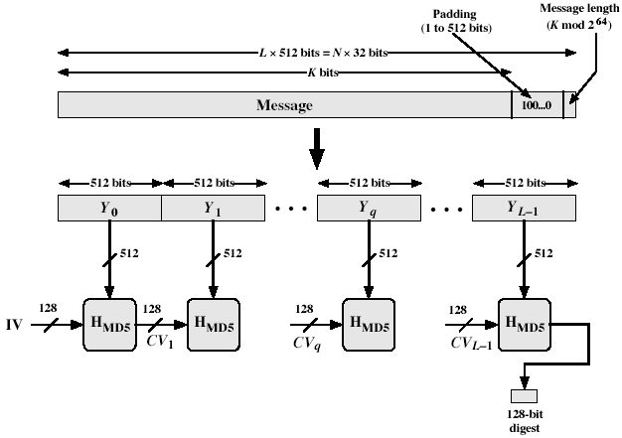
MD5 Processing
9/21/2004

Slide 25
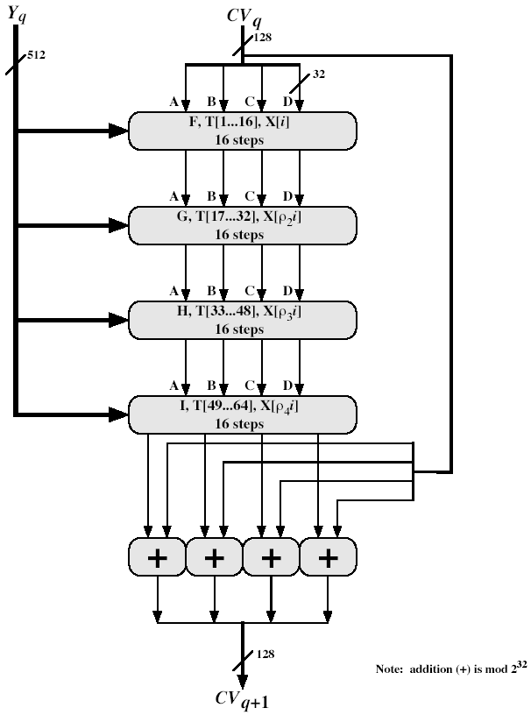
MD5 Processing of 512-bit Block
9/21/2004

Slide 26
MD5 Compression Function
Each round has 16 steps of the form:
  a <- b+((a+g(b,c,d)+X[k]+T[i])<<<s)
a,b,c,d refer to the 4 words of the buffer, but used in varying permutations
  note each step updates only 1 word of the buffer
  after 16 steps each word is updated 4 times
g(b,c,d) is a different nonlinear function in each round (F,G,H,I)
T[i] is a constant value derived from sine
9/21/2004

Slide 27
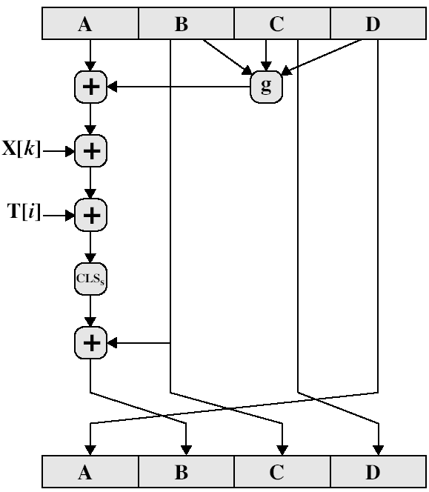
MD5 Compression Function
9/21/2004

Slide 28
Security of MD5
MD5 hash is dependent on all message bits
Rivest claims security is good as can be
However known attacks include
  Berson in 1992 attacked any 1 round using differential cryptanalysis (but can’t extend)
  Boer & Bosselaers in 1993 found a pseudo collision (again unable to extend)
  Dobbertin in 1996 created collisions on MD compression function (but initial constants prevent exploit)
  Wang et al announced cracking MD5 on Aug 17, 2004 (paper available on Useful Links)
Thus MD5 looks vulnerable soon
9/21/2004

Slide 29
Secure Hash Algorithm (SHA-1)
Designed by NIST & NSA in 1993, revised 1995 as SHA-1
US standard for use with DSA signature scheme
  standard is FIPS 180-1 1995, also Internet RFC3174
Produce hash values of 160 bits (20 bytes)
Now the generally preferred hash algorithm
Based on design of MD4 with key differences
9/21/2004

Slide 30
SHA-1 Overview
pad message so its length is 448 mod 512
append a 64-bit length value to message
initialize 5-word (160-bit) buffer (A,B,C,D,E) to
  (67452301,efcdab89,98badcfe,10325476,c3d2e1f0)
process message in 16-word (512-bit) chunks:
  expand 16 words into 80 words by mixing & shifting
  use 4 rounds of 20 bit operations on message block & buffer
  add output to input to form new buffer value
output hash value is the final buffer value
9/21/2004

Slide 31
SHA-1 Compression Function
Each round has 20 steps which replaces the 5 buffer words thus:
  (A,B,C,D,E) <-(E+f(t,B,C,D)+(A<<5)+W_{t}+K_{t}),A,(B<<30),C,D)
a,b,c,d refer to the 4 words of the buffer
t is the step number
f(t,B,C,D) is nonlinear function for round
W_{t} is derived from the message block
K_{t} is a constant value derived from sine
9/21/2004

Slide 32
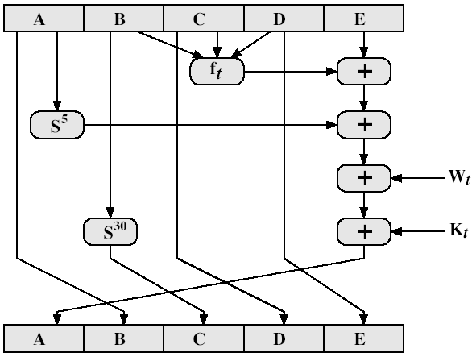
SHA-1 Compression Function
9/21/2004

Slide 33
SHA-1 vs MD5
Brute force attack is harder (160 vs 128 bits for MD5)
Not vulnerable to any known attacks (compared to MD4 and MD5)
A little slower than MD5 (80 vs 64 steps)
Both designed as simple and compact
Optimised for big-endian CPU’s (vs MD5 which is optimised for little-endian CPU’s)
9/21/2004

Slide 34
Summary
have considered:
  message authentication using
  message encryption
  MACs
  hash functions
  general approach & security
Notes:
Chapter 11 summary.

